Slide 1
Chapter 4: Data Link Layer (OSI Model)
Network Access
Notes:
Cisco Networking Academy program
Introduction to Networks
Chapter 4: Network Access

Slide 2
Chapter 4
4.1 Data Link Layer Protocols
4.2 Media Access Control
4.3 Summary
Notes:
Chapter 4 Sections

Slide 3
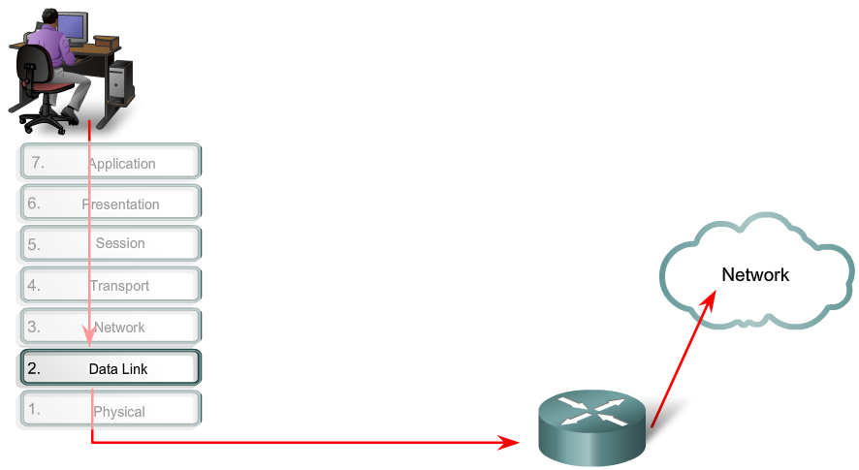
Purpose of the Data Link Layer 4.1 The Data Link Layer
Notes:
Section 4.3.1.1

Slide 4
Purpose of the Data Link Layer Data Link Sublayers
Network
Data Link | LLC Sublayer
 | MAC Sublayer
Physical
802.3
Ethernet
802.11
Wi-Fi
802.15
Bluetooth
Notes:
Section 4.3.1.2

Slide 5
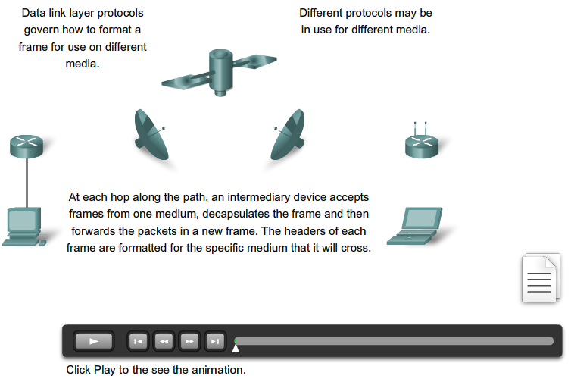
Purpose of the Data Link Layer 4.2 Media Access Control
Notes:
Section 4.3.1.3

Slide 6
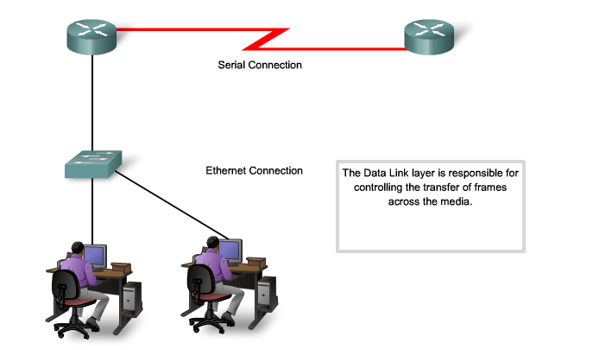
Purpose of the Data Link Layer Providing Access to Media
Notes:
Section 4.3.1.4

Slide 7
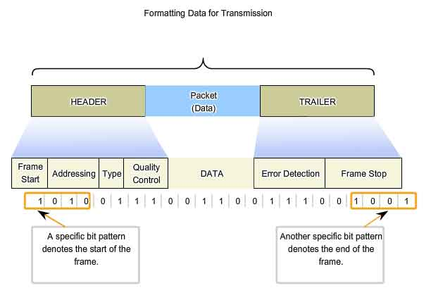
Data Link Layer Layer 2 Frame Structure
Notes:
Section 4.3.2.1

Slide 8
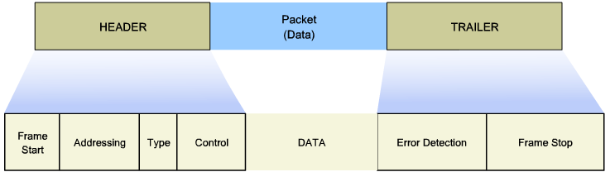
Layer 2 Frame Structure Creating a Frame
Notes:
Section 4.3.2.2

Slide 9
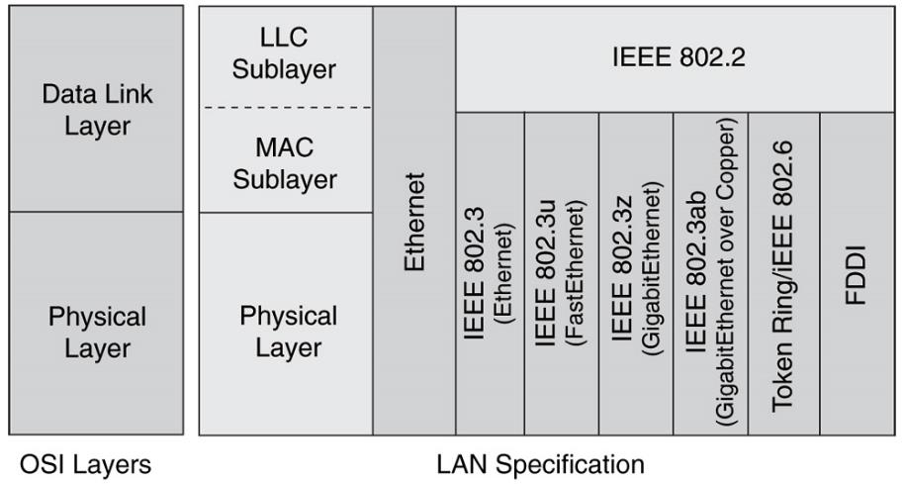
Data Link Layer Layer 2 Standards
Notes:
Section 4.3.3

Slide 10
Layer 2 Standards Data Link Layer Standards
Standard organization | Networking Standards
IEEE | 802.2: Logical Link Control (LLC) 802.3: Ethernet 802.4: Token bus 802.5: Token passing 802.11: Wireless LAN (WLAN) & Mesh (Wi-Fi certification) 802.15: Bluetooth 802.16: WiMax
ITU-T | G.992: ADSL G.8100 - G.8199: MPLS over Transport aspects Q.921: ISDN Q.922: Frame Relay
ISO | HDLC (High Level Data Link Control) ISO 9314: FDDI Media Access Control (MAC)
ANSI | X3T9.5 and X3T12: Fiber Distributed Data Interface (FDDI)
Notes:
Section 4.3.3.1

Slide 11
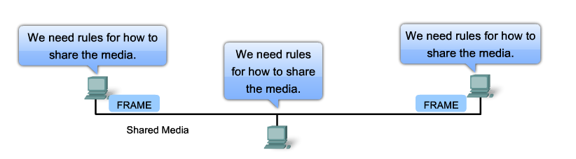
Topologies Controlling Access to the Media
Notes:
Section 4.4.1.1

Slide 12
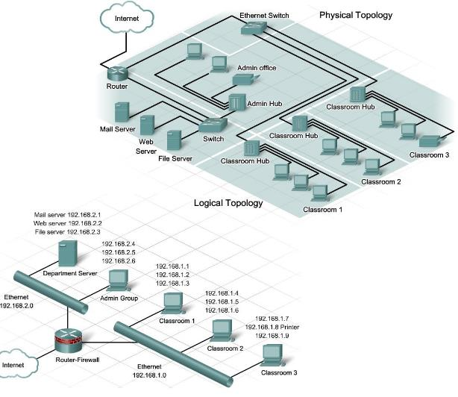
Topologies Physical and Logical Topologies
Notes:
Section 4.4.1.2

Slide 13
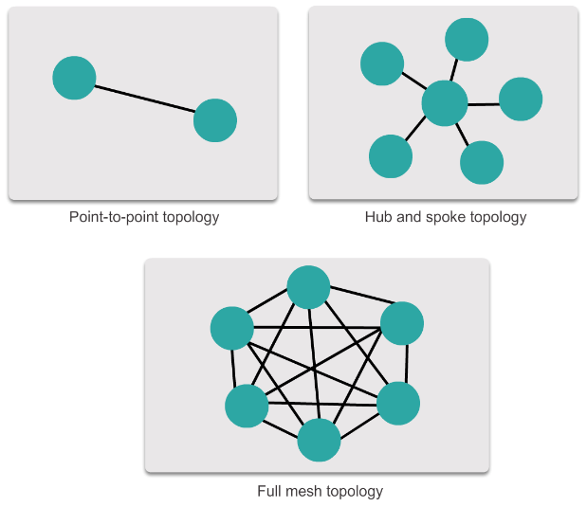
WAN Topologies Common Physical WAN Topologies
Notes:
Section 4.4.2.1

Slide 14
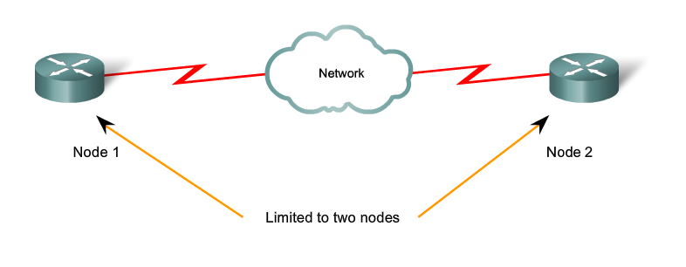
WAN Topologies Physical Point-to-Point Topology
Notes:
Section 4.4.2.2

Slide 15
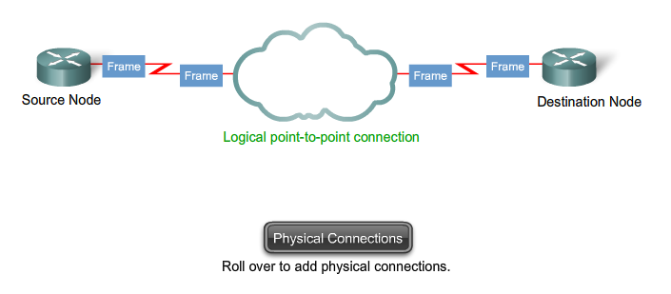
WAN Topologies Logical Point-to-Point Topology
Notes:
Section 4.4.2.3

Slide 16
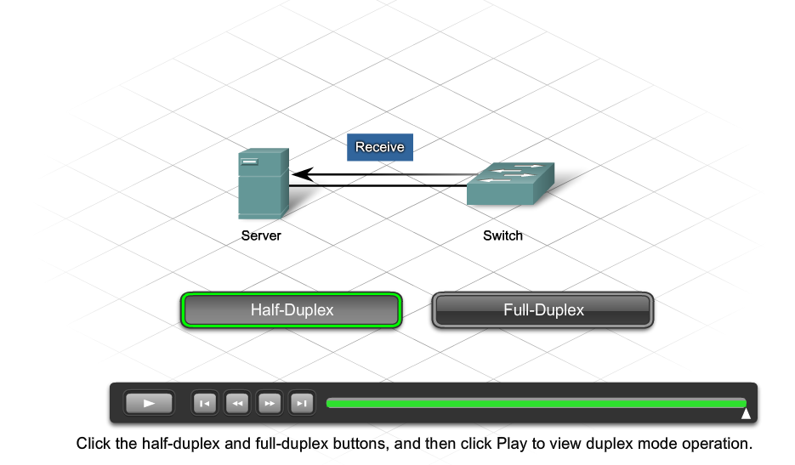
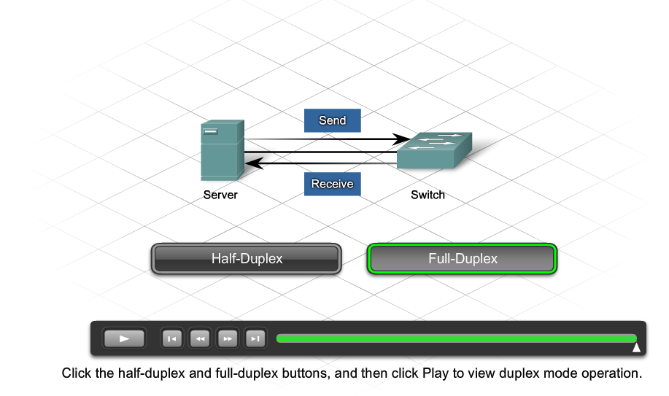
WAN Topologies Half and Full Duplex
Notes:
Section 4.4.2.4

Slide 17
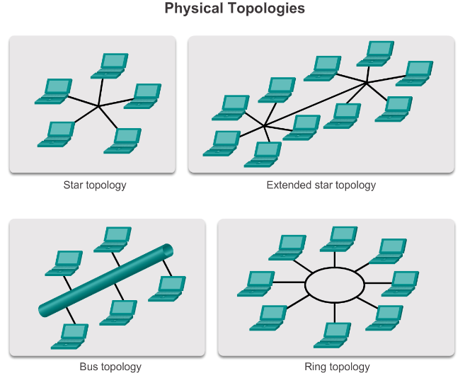
LAN Topologies Physical LAN Topologies
Notes:
Section 4.4.3.1

Slide 18
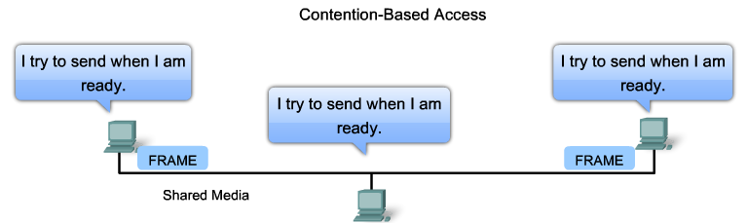
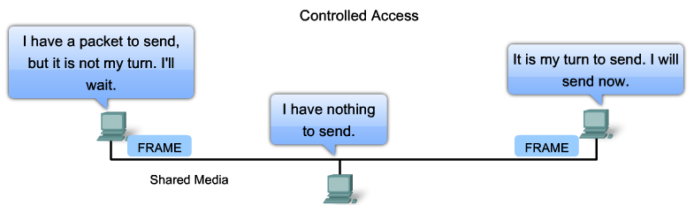
LAN Topologies Logical Topology for Shared Media
Notes:
Section 4.4.3.2

Slide 19
LAN Topologies Contention-Based Access
Characteristics | Contention-Based Technologies
Stations can transmit at any time Collision exist There are mechanisms to resolve contention for the media | CSMA/CD for 802.3 Ethernet networks CSMA/CA for 802.11 wireless networks
Notes:
Section 4.4.3.3

Slide 20
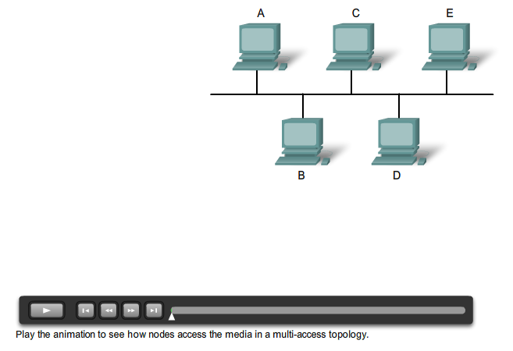
LAN Topologies Multi-Access Topology
Notes:
Section 4.4.3.4

Slide 21
LAN Topologies Controlled Access
Characteristics | Controlled Access Technologies
Only one station can transmit at a time Devices wishing to transmit must wait their turn No collisions May use a token passing method | Token Ring (IEEE 802.5) Fiber Distributed Data Interface (FDDI)
Notes:
Section 4.4.3.5

Slide 22
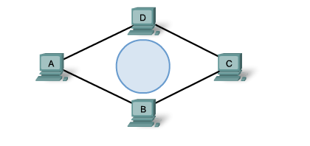
LAN Topologies Ring Topology
Notes:
Section 4.4.3.6

Slide 23
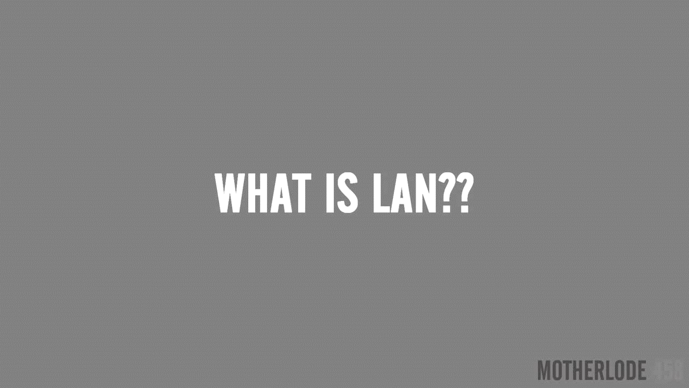
(LAN) explained – Video
Notes:
Chap4-Local Area Network (LAN) explained!

Slide 24
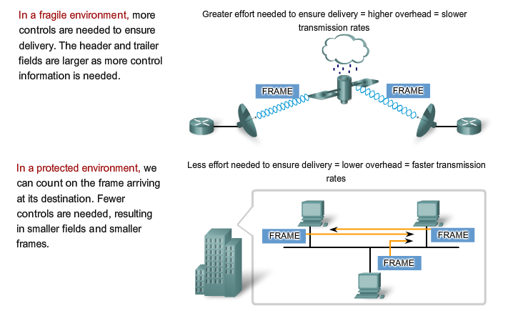
Data Link Frame The Frame
Notes:
Section 4.4.4.1

Slide 25
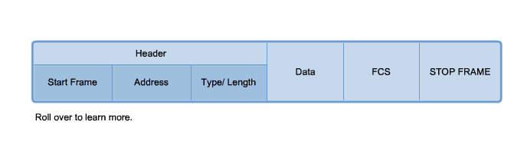
Data Link Frame The Header
Notes:
Section 4.4.4.2

Slide 26
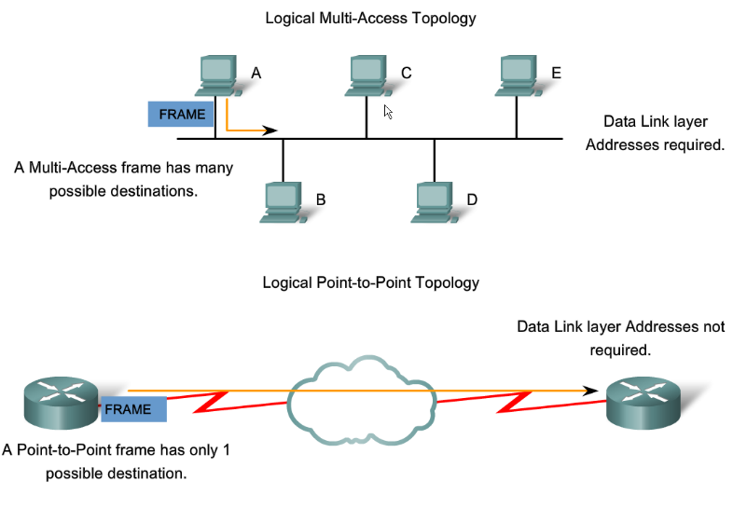
Data Link Frame Layer 2 Address
Notes:
Section 4.4.4.3

Slide 27
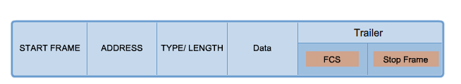
Data Link Frame The Trailer
Notes:
Section 4.4.4.4

Slide 28
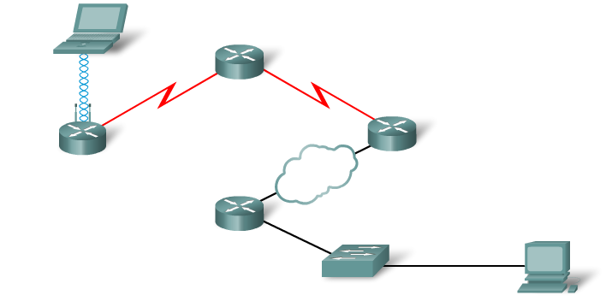
Data Link Frame LAN and WAN Frames
Notes:
Section 4.4.4.5

Slide 29
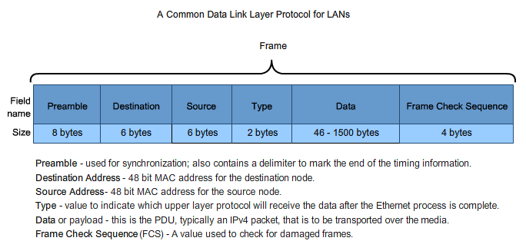
Data Link Frame Ethernet Frame
Notes:
Section 4.4.4.6

Slide 30
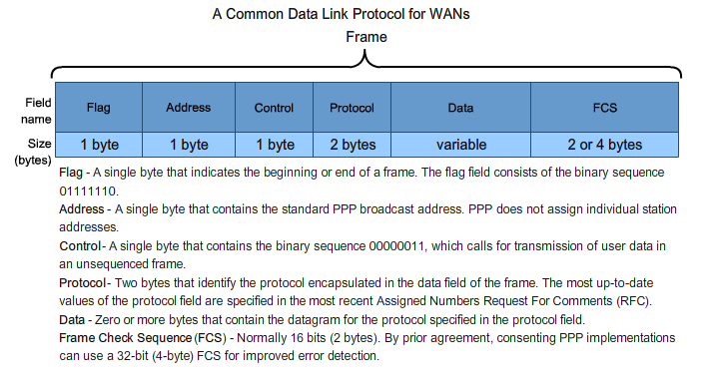
Data Link Frame Point-to-Point Protocol Frame
Notes:
Section 4.4.4.7

Slide 31
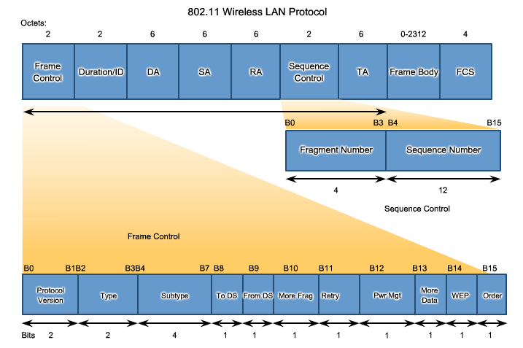
Data Link Frame 802.11 Wireless Frame
Notes:
Section 4.4.4.8

Slide 32
Network Access Summary
Data Link Layer Protocols
Media Access Control
Notes:
Section 4.5

Slide 33
